Slide 1
Computer Networking
Software-Defined Networking (SDN)

Slide 2
Software-Defined Networking
Motivation
Enterprise network management
Scalable SDN
Readings:
  A Clean Slate 4D Approach to Network Control and Management
  Onix: A Distributed Control Platform for Large-scale Production Networks
Optional reading
  Ethane: Taking Control of the Enterprise

Slide 3
Software-Defined Networking
Motivation
Enterprise network management
Scalable SDN
Readings:
  A Clean Slate 4D Approach to Network Control and
  Management
  Onix: A Distributed Control Platform for Large-scale Production Networks
Optional reading
  Ethane: Taking Control of the Enterprise

Slide 4
4D: Motivation
Network management is difficult!
Operators goals should be implemented as “workarounds”
Observation: current Internet architecture bundles control logic and packet handling (e.g., OSPF)
Challenge: how to systematically enforce various, increasingly complex high-level goals?

Slide 5
Design choices
Incremental deployment
  Advantage: easier to implement
  Disadvantage: point solution?
4D advocates a clean-slate approach
  Build control plane/network management from the ground up
  Constraint: no change of packet formats
Insight: Decouple the control and data planes

Slide 6
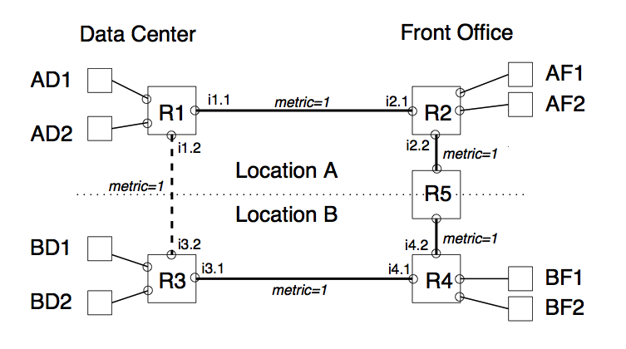
Example 1:
Front- Office Data Center ACL
Notes:
Interface i1.1 is configured with a packet filter that drops all packets from the BF subnet, and interface i3.1 drops all packets from the AF subnet.
The new link (dotted) changes the routing such that packets sent from AF to BD will travel from R2 to R1 to R3 to BD—completely avoiding the packet filter installed on interface i3.1

Slide 7
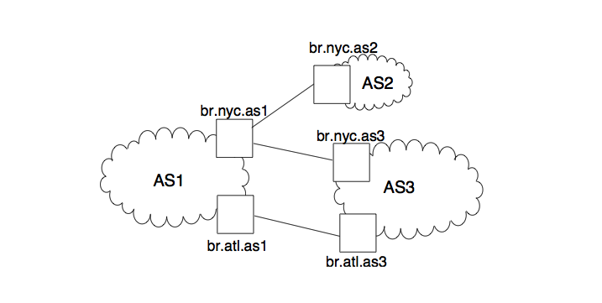
Example 2: Spurious Routing
Notes:
If AS1’s policy is to not provide AS3 with transit service for d, it does not announce d in its eBGP sessions with AS3. However, if AS3 wishes to be unscrupulous (e.g., use AS1 for transit service without paying), it can assume AS1 does know a way to d (e.g., so AS1’s own customers can reach d). If AS3 sends packets for d to br.nyc.as1, they will definitely be delivered, as br.nyc.as1 must have a route to d in order to handle legitimate traffic from AS2.

Slide 8
Management today
Data plane
  Packet forwarding mechanisms
Control plane
  Routing protocols
  Distributed
Management plane
  Has to reverse engineer what the control plane does
  Work around rather than work with!

Slide 9
Driving principles
Network-level objectives
  High-level, not after-the-fact
Network-wide views
  Measurement/monitoring/diagnosis
Direct control
  No more “reverse engineering” or “inversion”
  Direct configuration

Slide 10
4D Architecture
Decision plane
  routing, access control, load balancing, …
Dissemination plane
  control information through an independent channel from data
Discovery plane
  discover net. elements and create a logical net. map
Data plane
  handle individual packets given state by decision plane (e.g., forwarding tables, load balancing schemes,…)

Slide 11
Advantages of 4D Architecture
Separate networking logic from distributed systems issues
Higher robustness
Better security
Accommodate heterogeneity
Enabling of innovation and network evolution

Slide 12
Challenges for 4D
Complexity – can we re-implement everything within 4D framework?
Stability failures – is network-wide view stable enough for decision making?
Scalability problems – will decision computation and dissemination scale?
Response time – will latency to central controller be an issue?
Security vulnerabilities

Slide 13
Research Agendas
Decision plane
Dissemination plane
Discovery plane
Data plane

Slide 14
Research Agendas
Decision plane
Dissemination plane
Discovery plane
Data plane

Slide 15
Research Agendas
Decision plane
  Algorithms Satisfying Network-Level Objectives
    Traffic engineering
    Reachability policies
    Planned maintenance
    Leveraging network structure
    Multiple network-level objectives
    Finding the right separation of timescales
  Coordination Between Decision Elements
  Introducing Hierarchy in the Decision Plane

Slide 16
Research Agendas
Decision plane
  Algorithms Satisfying Network-Level Objectives
  Coordination Between Decision Elements
    Distributed election algorithms
    Independent DEs
  Introducing Hierarchy in the Decision Plane

Slide 17
Research Agendas
Decision plane
  Algorithms Satisfying Network-Level Objectives
  Coordination Between Decision Elements
  Introducing Hierarchy in the Decision Plane
    Large network managed by a single institution
    Multiple networks managed by different institutions

Slide 18
Research Agendas
Decision plane
Dissemination plane
  Connecting decision elements with routers/switches
    Flooding vs. spanning-tree vs. source routing
  Achieving direct control
    Consistent update semantics
Discovery plane
Data plane

Slide 19
Research Agendas
Decision plane
Dissemination plane
Discovery plane
  Support for decision-plane algorithms
    Accuracy and naming
  Bootstrapping with zero pre-configuration beyond a secure key
  Supporting cross-layer auto-discovery
Data plane

Slide 20
Research Agendas
Decision plane
Dissemination plane
Discovery plane
Data plane
  Packet-forwarding paradigms
  Advanced data-plane features

Slide 21

Where are we?
Controller
4D
(vision)
Config
Config

Slide 22
Where are we?
Controller
OpenFlow
Config
Config

Slide 23
Where are we?
Controller
Ethane
(concrete
example)
Config
Config

Slide 24
Where are we?
Controller
E.g., ONIX
Config
Config

Slide 25
Software-Defined Networking
Motivation
Enterprise network management
Scalable SDN
Readings:
  A Clean Slate 4D Approach to Network Control and Management
  Onix: A Distributed Control Platform for Large-scale Production Networks
Optional reading
  Ethane: Taking Control of the Enterprise

Slide 26
Motivation
Enterprise configuration
  Error prone: 60% of failures due to human error
  Expensive: 80% of IT budget spent on maintenance and operations
Existing solutions
  Place middleboxes at chokepoints
  Retrofit via Ethernet/IP mechanisms

Slide 27
Driving question
Make enterprises more manageable
What’s good about enterprises
  Security policies are critical
  Already somewhat centralized

Slide 28
Three principles in Ethane
Descriptive/declarative policies
  Tie it to names not locations/addresses
Packet paths determined explicitly by policy
Binding between packet and origin
  No spoofing
  Accountability

Slide 29
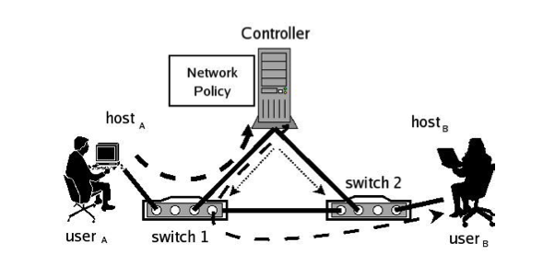
How Ethane Works
First packet sent to Controller
Subsequent packets use FlowTable
No host-to-host communication without explicit permission

Slide 30
Ethane in use
Registration
  explicit registration of users, hosts, and switches
Bootstrapping
  spanning tree
Authentication
  controller authenticates the host and assigns IP
  user authenticates through a web form
4. Flow set up
5. Forwarding

Slide 31
Switch Design
Simplified Ethernet-like switch
  No VPN, no routing protocols, smaller tables, etc.
Flow Table
  Controller-only update
  Forward/drop actions
Local switch manager
  Maintains secure channel to controller

Slide 32
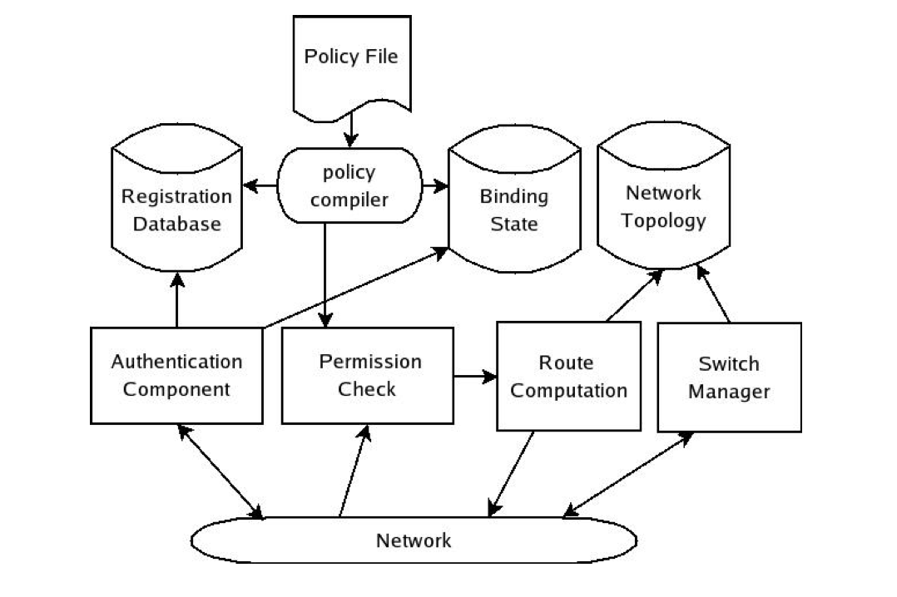
Controller Design Components
Explicit per-flow way-pointing

Slide 33
Reliability
Cold standby
  Primary controller is root of spanning tree
  Switches/users need to re-auth
Warm standby
  Separate spanning tree for every controller
  Replicate bindings among controllers
  Only latest switches/users need to re-auth
Fully replicated
  Multiple active controllers
  Partition workload

Slide 34
Policy Language
Common tasks expressed as predicates
Allow, deny, waypoint
Interpret vs compile

Slide 35
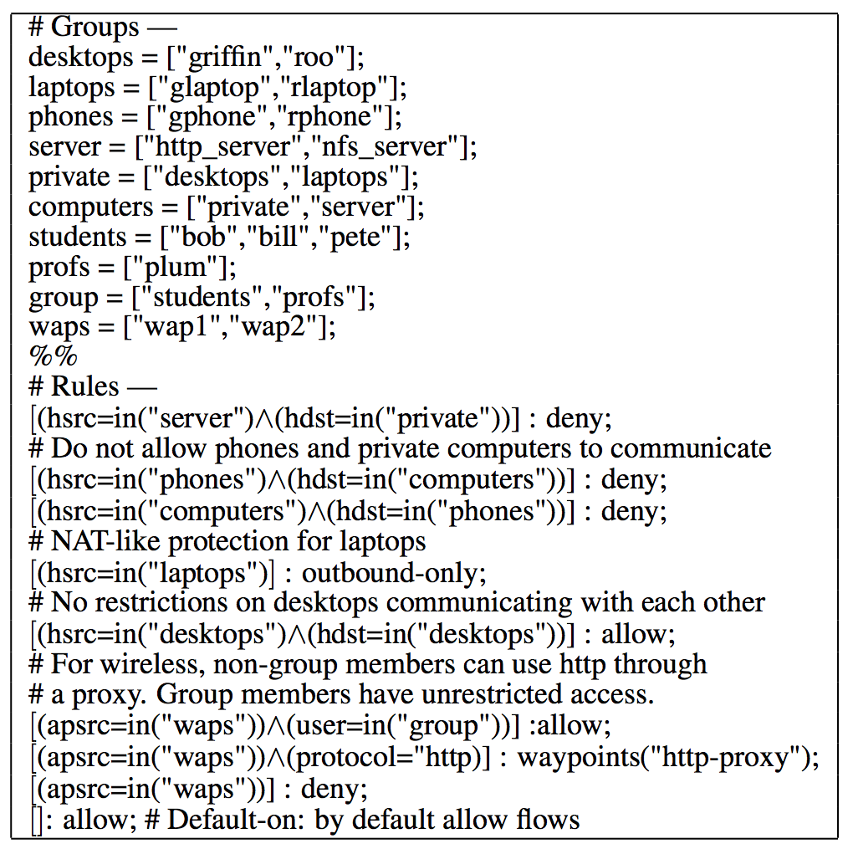
Policy Language

Slide 36
Evaluation
Mostly “feasibility”
Trace-driven evaluations
Failure emulation
Scalability of request rate
End-to-end performance

Slide 37
Ethane Prototype
300 hosts in CS department at Stanford
Multiple “switches”
  Wireless access point, linux, netfpga
Controller
  Standard linux PC
  Linux PC (1.6GHz Celeron CPU and 512MB of DRAM)
Controller handles 10,000 flows per second

Slide 38
Experiences
Once deployed, easy to manage
Add new switches, users is easy
Journaling helps debugging
Adding new features is easy

Slide 39
Advantages of Ethane
Switches
  Dumb
  No complex distributed protocol
  Focus purely on forwarding
  Save forwarding rule space (try to keep only “active” flows)

Slide 40
Comments on Design
Common vs worst case design?
Latency, scalability

Slide 41
Potential concerns
Controller “DDoS”
Controller scalability
Broadcast traffic
Latency

Slide 42
Software-Defined Networking
Motivation
Enterprise network management
Scalable SDN
Readings:
  A Clean Slate 4D Approach to Network Control and Management
  Onix: A Distributed Control Platform for Large-scale Production Networks
Optional reading
  Ethane: Taking Control of the Enterprise

Slide 43
ONIX
Controller
ONIX
Config
Config
ONIX: How to build a controller platform?

Slide 44
What are the key challenges?
Usability
Performance
Flexibility
Scalability
Reliability/availability
…

Slide 45
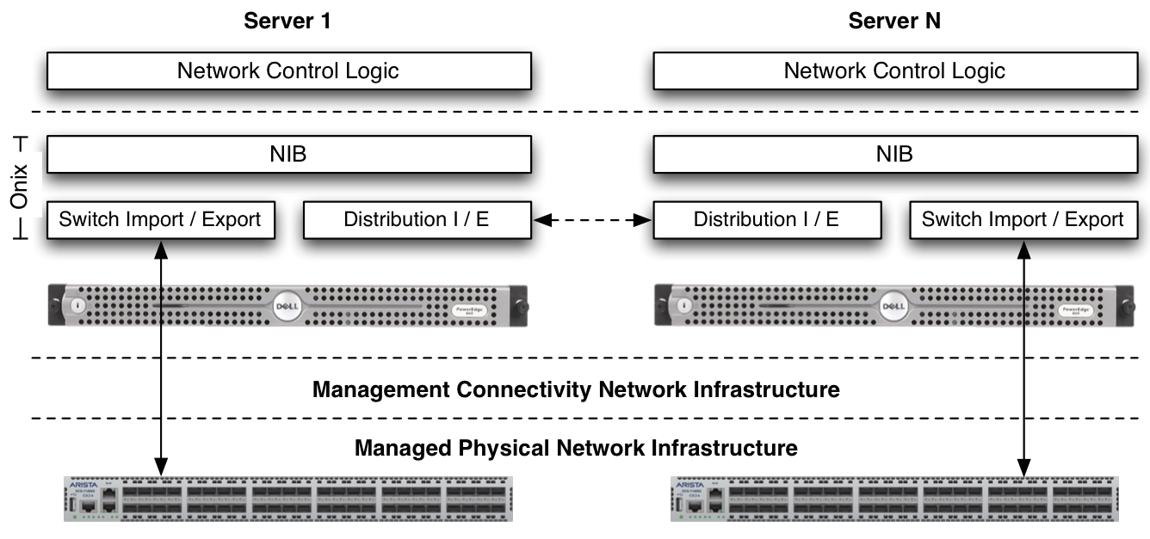
ONIX

Slide 46
ONIX Design Decisions
“Data-centric” API
Treat all networking actions as data actions
  Read
  Alter
  Register for changes in network state

Slide 47
Core component == NIB
Network information base
  Analogous to forwarding information base
Graph of all network entities
  Switches, ports, interfaces, links etc
Applications read/register/manipulate NIB

Slide 48
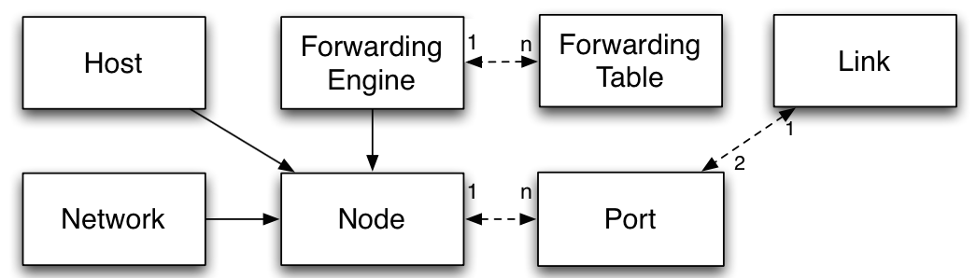
Core component == NIB
NIB is a collection network entities
Each entity is a key-value pair
Default network entity classes

Slide 49
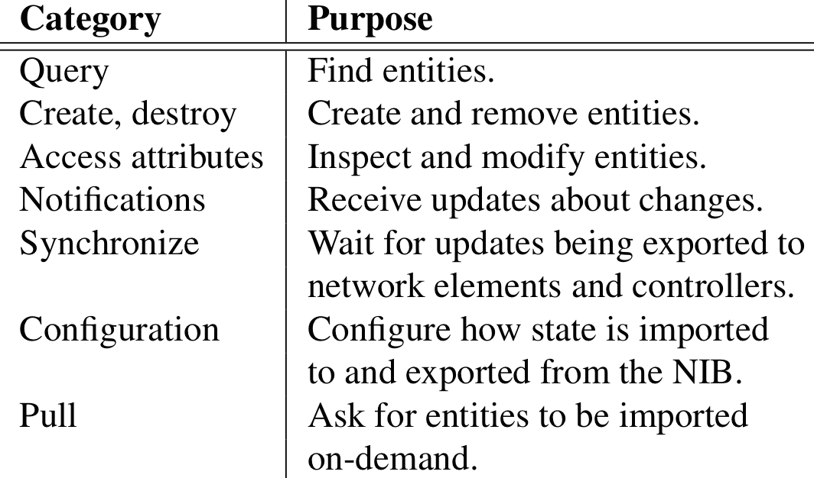
ONIX NIB APIs
Functions provided by the ONIX NIB API

Slide 50
Three scalability strategies
Partition
  Can we split the state into independent sub-sets?
  E.g., different subnet forwarding rules on a switch
Aggregate
  zoom-in/zoom-out at different aggregation levels
Tradeoff with weaker consistency/durability
  E.g., replicated transactional DB for network topology
  E.g., one-hop DHT for link utilization info

Slide 51
Two types of datastores
DHT with weak eventual consistency
  Used for “high” churn events
  Frequent updates
Transactional store with strong guarantees
  Used for “low” churn events
  E.g., network policy

Slide 52
Reliability
Network element failure
  discovered by traditional data plane mechanisms
  application is in charge of deciding about the alternative policy after node/link failure
ONIX instance failure
  Option 1: other instances detect failure and take over
  Option 2: have multiple instances manage each network element at all times (ONIX helps handles consistency)
Infrastructure failure
  Use dedicated control backbone

Slide 53
Killer apps for ONIX
Why did VMWare buy Nicira?
Distributed Virtual Switch
Multi-tenant virtualization

Slide 54
Summary
4D: An general vision for design
Ethane: End-to-end enterprise network management
ONIX: A distributed control platform

